Slide 1
Discrete Mathematics
Xiaowei Yang
South China University of Technology

Slide 2
Chapter 5. Relations
Equivalence Relations
Section 5.5

Slide 3
Contents
1
Equivalence Relations
2
Equivalence Class
3
Equivalence and Partitions

Slide 4
Equivalence Relations

Slide 5
§5.5: Equivalence Relations
Definition: An equivalence relation on a set A is any binary relation on A that is reflexive, symmetric, and transitive.
  E.g., = is an equivalence relation.
  But many other relations follow this pattern too

Slide 6
§5.5: Equivalence Relations
Definition: An equivalence relation on a set A is any binary relation on A that is reflexive, symmetric, and transitive.
E.g., = is an equivalence relation.
For any function f:A→B, the relation “have the same f value”, or =_{f} :≡ {(a₁,a₂) | f(a₁)=f(a₂)}
is an equivalence relation,
e.g., let m=“mother of” then =_{m} = “have the same mother” is an equivalence relation

Slide 7
Equivalence Relation Examples
“Strings a and b are the same length.”
“Integers a and b have the same absolute value.”
Let’s talk about relations between functions:
How about: R={(f,g) | f(2)=g(2)} ?
How about: R={(f,g) |f(1)=g(1)∨f(2)=g(2)} ?

Slide 8
Equivalence Relation Examples
How about: R={(f,g) | f(2)=g(2)} ?
Yes. Reflexivity: f(2)=f(2), for all f
Sym: f(2)=g(2) implies g(2)=f(2)
Trans: f(2)=g(2) and g(2)=h(2)
implies f(2)=h(2).

Slide 9
Equivalence Relation Examples
How about R={(f,g) |f(1)=g(1)∨f(2)=g(2)}?
No. Counterexample against transitivity:
f(1)=a, f(2)=b
g(1)=a, g(2)=c
h(1)=b, h(2)=c

Slide 10
Example 1
Congruence Modulo m
Let m be a positive integer with m>1. Show that the relation
R = { (a,b) | a ≡ b (mod m) }
is an equivalence relation on the set of integers.

Slide 11
Equivalence Class

Slide 12
Definition 2
Let R be an equivalence relation on a set A.
The set of all elements that are related to an element a of A is called the equivalence class of a.
The equivalence class of a with respect to R is denoted by [a]R.
When only one relation is under consideration, we will delete the subscript R and write [a] for this equivalence class.

Slide 13
In other words, if R is an equivalence on a set A, the equivalence class of the element a is
[a]R = { s | (a,s) ∈ R }
If b∈[a]R , then b is called a representative of this equivalence class. Any element of a class can be used as a representative of this class.
[0]={…,-8,-4,0,4,8,…}

Slide 14
Equivalence Classes
Why can we talk so loosely about elements being equivalent to each other (as if the relation didn’t have a direction)?
In some sense, it does not matter which representative of an equivalence class you take as your starting point:
If aRb then { x | aRx } = { x | bRx }

Slide 15
Equivalence Classes
If aRb then aRx ⇔ bRx
Proof:
1. Suppose aRb while bRx.
Then aRx follows directly by transitivity.
2. Suppose aRb while aRx.
aRb implies bRa (symmetry). But
bRa and aRx imply bRx by transitivity

Slide 16
Equivalence Classes
We now know that
If aRb then { x | aRx } = { x | bRx }
Equally,
If aRb then { x | xRa } = { x | xRb }
(due to symmetry)
In other words, an equivalence class based on R is simply a maximal set of things related by R

Slide 17
Equivalence Class Examples
“(Strings a and b) have the same length.”
  Suppose a has length 3. Then [a] =
  the set of all strings of length 3.
“(Integers a and b) have the same
absolute value.”
  [a] = the set {a, −a}

Slide 18
Equivalence and Partitions

Slide 19
Partitions
A partition of a set A is a collection of disjoint nonempty subsets of A
that have A as their union.
Intuitively: a partition of A
divides A into separate parts (in such
a way that there is no remainder).

Slide 20
Partitions and equivalence classes
Consider a partition of a set A into A₁, ..A_{n}
  The A_{i}’s are all disjoint : For all x and for all i, if x∈A_{i} and x∈A_{j} then A_{i} = A_{j}
  The union of the A_{i}’s = A

Slide 21
Partitions and equivalence classes
A partition of a set A can be viewed as the set of all the equivalence classes {A₁, A₂, … } for some equivalence relation on A.
For example, consider the set A={1,2,3,4,5,6} and its partition {{1,2,3},{4},{5,6}}
R = { (1,1),(2,2),(3,3),(1,2),(1,3),(2,3),(2,1),(3,1),
(3,2) ,(4,4), (5,5),(6,6),(5,6),(6,5) }

Slide 22
Partitions and equivalence classes
We sometimes say:
  A partition of A induces an equivalence relation on A
  An equivalence relation on A induces a partition of A

Slide 23
Properties of Partitions
Theorem 1 Let R be an equivalence relation on a set A. These statements are equivalent:
(i) a R b
(ii) [a] = [b]
(iii) [a] ∩ [b] ≠ Ø

Slide 24
Properties of Partitions
Theorem 2 Let R be an equivalence relation on a set S.
Then the equivalence classes of R form a partition { Ai | i ∈ I} of the set S, there is an equivalence relation R that has the sets Ai, i ∈ I, as its equivalence classes.

Slide 25
Example 2
List the ordered pairs in the equivalence relation R produced by the partition
A1 = {1,2,3}, A2={4,5}, and A3={6} of S={1,2,3,4,5,6}, given in Example 7.

Slide 26
Applications

Slide 27

Applications
设R表示S S上的二元关系，当且仅当xy=uv时，便有<x,y>R<u,v>，试证明R是
S S上的等价关系

Slide 28

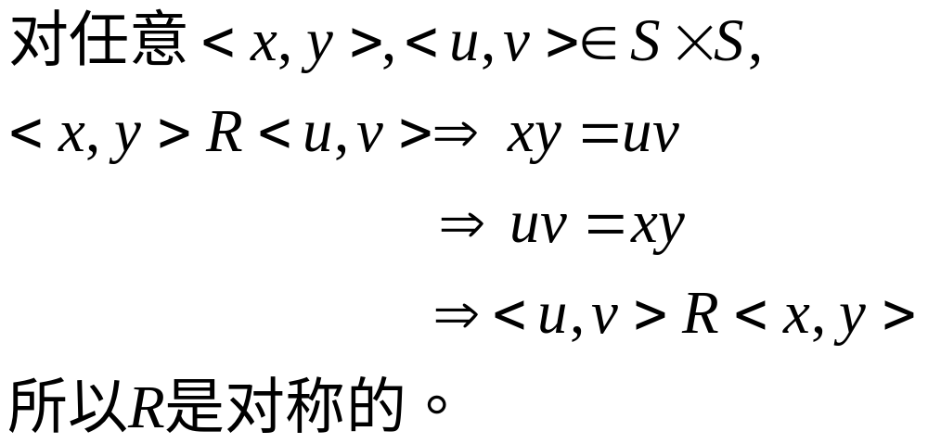
Applications
证明
（1）对任意<x,y> S S，由xy=xy，所以<x,y>R<x,y>。所以R是自反的。
（2）

Slide 29
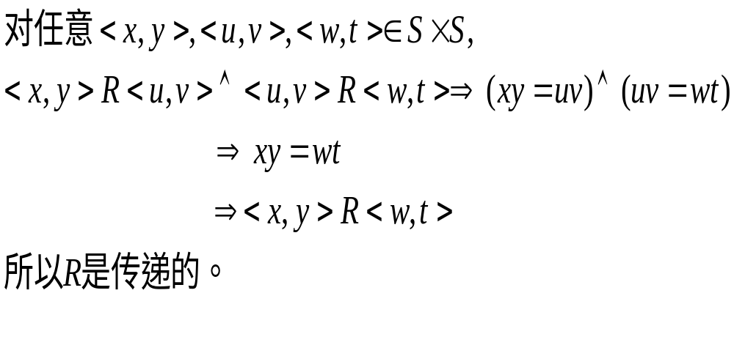
Applications
证明
（3）
由（1）（2）（3）知，R是等价关系。

Slide 30
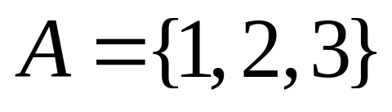
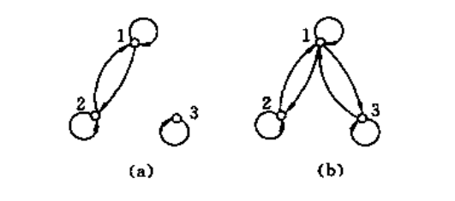
Applications
2.令 ，在A上的关系如图所示，判断他们是否等价关系

Slide 31
Applications
Solution.
关系是自反、对称、传递的。所以(a)图是等价的。
关系是自反、对称、但不传递。所以(b)图不是等价关系。

Slide 32
End of Section 5.5
Click to edit company slogan .

